Slide 1

DBMS PROJECT : MATRIMONIAL SITE DATABASE
DONE BY :
21CSB0F11 BRAHAMDEV SAH

Slide 2
Problem statement:
The Matrimonial site or marriage website is online platform that works as marriage broker. The matrimonial website is an online platform that help people to find life partner by their choice. This website provide feature for both grooms and brides to find their matching life partner.
It has the features like:
1.Messaging to matched preferences.
2.sending invitation to other users.
3.View other’s profile
user of the system:
1.Admin
2.Member

Slide 3
Problem statement:
features of the Admin:
He can view User details
He can block or unblock a user
He can edit user details, family details, partner preferences
He can even delete a user
features of the member:
member has to enter their Personal details,family details,partner preferences
After entering these details one can login and can able to see their opposite sex profile applied there
Also you can send invitation to other users(whom you are looking for) and if the user accepts your invitation you can send message to each other.
Also a user can search other users
There is simple search with ID features

Slide 4
Project description:
Here I have designed a database of matrimonial site which consists of six different entity.
1.User : It has attribute like userid(primary key), username, email-id and password.
2.Profile : It has attribute like profile_id (primary key),userid(foreign key),first name, middle name, last name,profile picture,education,occupation,gender,religion,interests,hobbies,date of birth,state,city ,street, street number and pincode and contact number. Since contact number is multivalued attribute so we normalized it.
3. contact number : Profile id(foreign key), contact number . There can be multiple contact number corresponding to single person.

Slide 5
Project description:
4. partner preference : This is the entity for partner preference for each and every person. It has attribute like preference id( primary key),user id(foreign key),minimum age , maximum age, gender, occupation, education, religion, city, state.
5. Match : This entity is for showing the matching score between opposite sex ( male and female).It has the attribute like match id( primary key),user id (foreign key),match status (whether it is completed or pending),match score (matching criteria between opposite sex),user-1-id(id of one person),user-2-id(id of another person). Here user1-id and user-2-id both are foreign key.
6. Message : This entity is for holding the message chat between different people. It has attribute like message id(primary key),sender id(user id of one people who is sending the message), receiver id(user id of another people who is receiving the message), message sent date and time( this is the date time stamp holding attribute shows when this message was delivered at what time.

Slide 6
Project description:
Relationship among various entity:
1. User has Profile: This is one to one relationship as one user should
have only one profile and one profile should be associated to only
one user id.
2. User placed partner-preferences: This is one to many relationship
as one user can able to place many partner-preferences.
3. User has match: This is many to many relationship as many user
have many match with their preference-partner.

Slide 7
Project description:
4.User sent message: This is one to many relationship as a user can
able to send message to different(many) other partner-
preferences(other user).

Slide 8
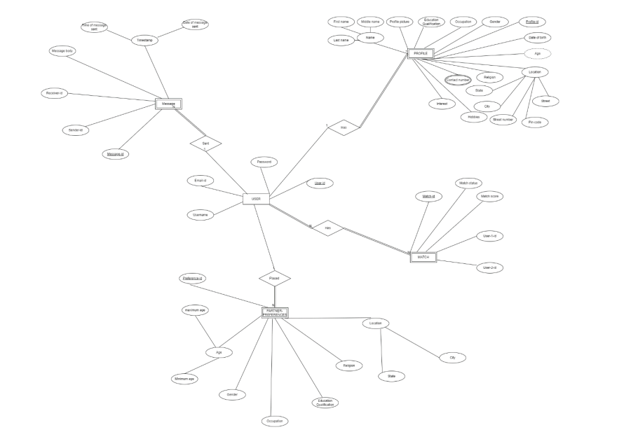
ER MODEL :

Slide 9
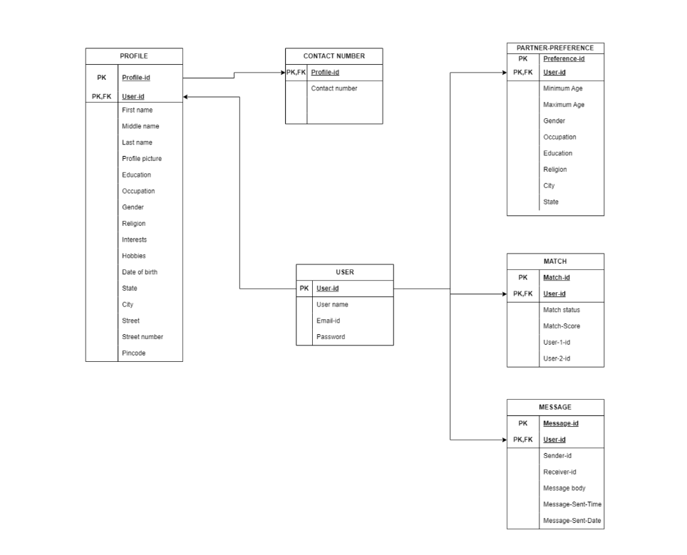
Relational schema:

Slide 10
Table creation:
create table user(
userid int primary key,
username varchar(100),
email_id varchar(100),
password varchar(100)
);

Slide 11
Table creation:
create table profile(
profile_id int primary key,
userid int,
first_name varchar(100),
middle_name varchar(100),
last_name varchar(100),
profile_picture varchar(20),
education varchar(100),
occupation varchar(100),
gender varchar(100),
religion varchar(100),
interests varchar(100),
hobbies varchar(100),
date_of_birth date,
state varchar(100),
city varchar(100),
street varchar(100),
street_number varchar(100),
pincode int,
foreign key(userid) references user(userid)
);

Slide 12
Table creation:
create table contact_number(
profile_id int,
contactnumber int,
foreign key(profile_id) references profile(profile_id)
);
create table partner_preference(
preference_id int primary key,
userid int,
minimum age int,
maximum age int,
gender varchar(20),
occupation varchar(100),
education varchar(100),
religion varchar(100),
city varchar(100),
state varchar(100),
foreign key(userid) references user(userid)
);

Slide 13
Table creation:
create table match(
match_id int primary key,
user_1_id int,
user_2_id int,
match_status varchar(100),
match_score int,
foreign key(user_1_id) references user(userid),
foreign key(user_2_id) references user(userid)
);

Slide 14
Table creation:
create table message(
message_id int primary key,
sender_id int,
receiver_id int,
message_body varchar(500),
massage_sent_date_and_time datetime,
foreign key(sender_id) references user(userid),
foreign key(receiver_id) references user(userid)
);

Slide 15
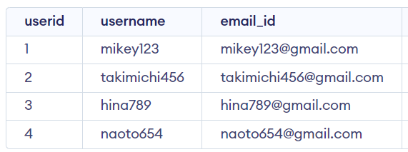
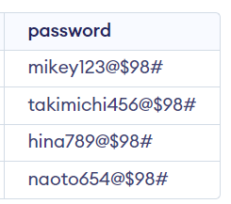
Value insertion:
insert into user values(1,'mikey123','mikey123@gmail.com','mikey123@$98#');
insert into user values(2,'takimichi456','takimichi456@gmail.com','takimichi456@$98#');
insert into user values(3,'hina789','hina789@gmail.com','hina789@$98#');
insert into user values(4,'naoto654','naoto654@gmail.com','naoto654@$98#');

Slide 16
Value insertion:
insert into profile values(11,1,'mikey','kumar','kun','mikey.jpg','M.tech','software engineer','male','hinduism','app development','reading books and gardening','2002-09-15','maharashtra','mumbai','bandra road','mb101-bandra',506001);
insert into profile values(12,2,'takimichi','kumar','mandal','takimichi.jpg','B.com','product manager','male','hinduism','digital marketing','exercise and workout','2000-06-24','telangana','hyderabad','jublee hills','th102-jublee',506002);
insert into profile values(13,3,'hina','kumari','yadav','hina.png','MBBS','neuro-sergeon','female','hinduism','neuro-transplant','exercise and sleeping','2000-04-16','tamilnadu','chennai','coimbatore','tc103-coimbatore','506003');
insert into profile values(14,4,'naoto','kumari','sah','naoto.jpg','B.tech in CSE','software developer','female','hinduism','AI and machine learning','exercise and cycling','2000-03-16','karnataka','banglore','mysore','kb104-mysore',506004);

Slide 17
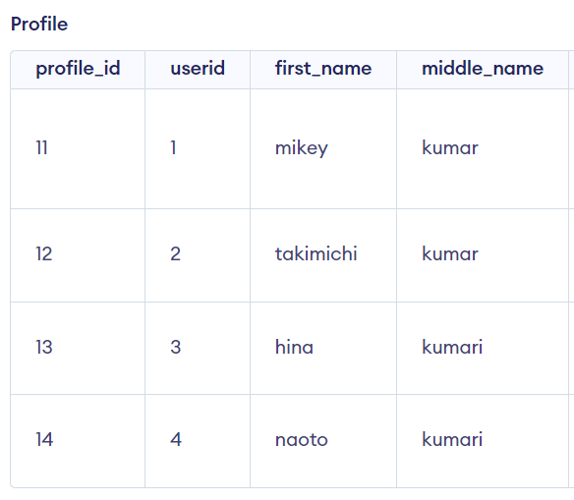
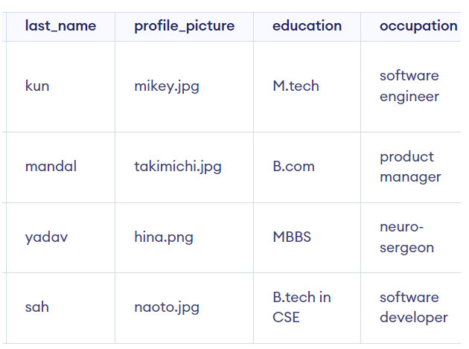
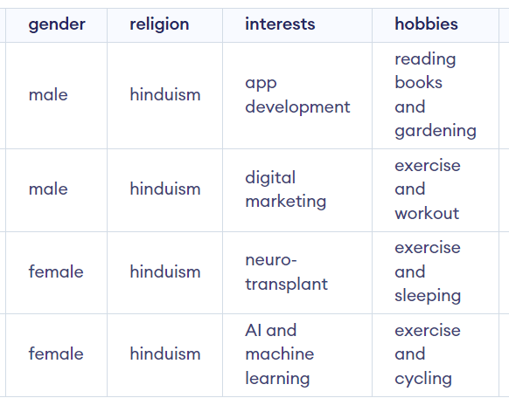
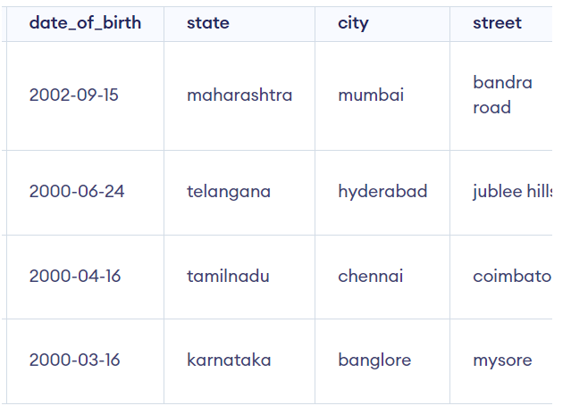
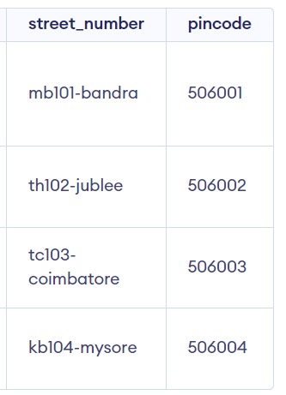
Value insertion:

Slide 18
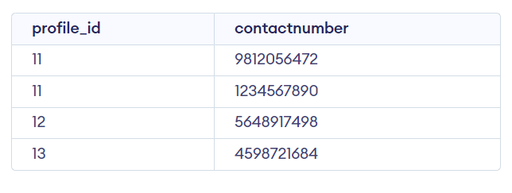
Value insertion:
insert into contact_number values(11,9812056472);
insert into contact_number values(11,1234567890);
insert into contact_number values(12,5648917498);
insert into contact_number values(13,4598721684);

Slide 19
Value insertion:
insert into partner_preference values(21,1,20,25,'female','neuro-sergeon','MBBS','hinduism','chennai','tamilnadu');
insert into partner_preference values(22,2,21,29,'female','software developer','B.tech in CSE','hinduism','banglore','karnataka');
insert into partner_preference values(23,3,22,28,'male','software engineer','M.tech','hinduism','mumbai','maharashtra');
insert into partner_preference values(24,4,19,24,'male','product manager','B.com','hinduism','hyderabad','telangana');

Slide 20
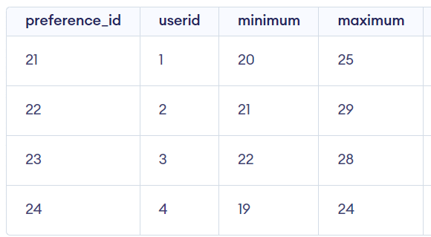
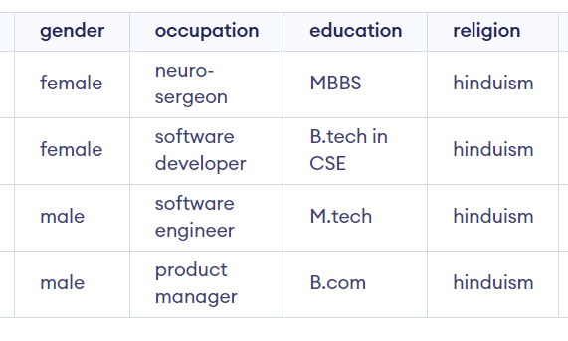
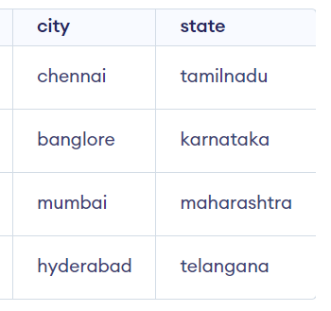
Value insertion:

Slide 21
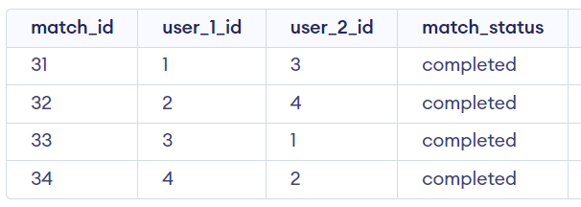
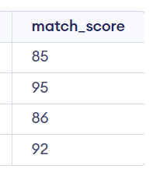
Value insertion:
insert into match values(31,1,3,'completed',85);
insert into match values(32,2,4,'completed',95);
insert into match values(33,3,1,'completed',86);
insert into match values(34,4,2,'completed',92);

Slide 22
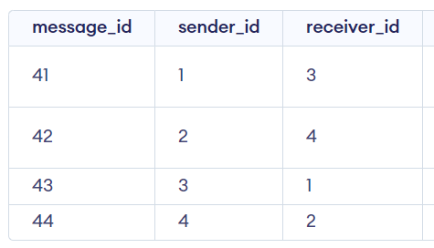
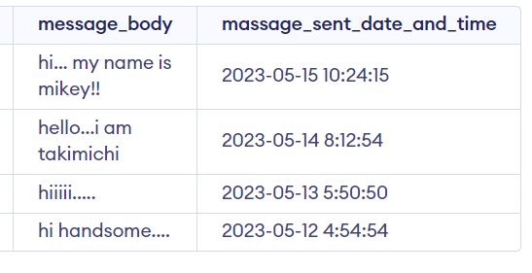
Value insertion:
insert into message values(41,1,3,'hi... my name is mikey!!','2023-05-15 10:24:15');
insert into message values(42,2,4,'hello...i am takimichi','2023-05-14 8:12:54');
insert into message values(43,3,1,'hiiiii.....','2023-05-13 5:50:50');
insert into message values(44,4,2,'hi handsome....','2023-05-12 4:54:54');*/

